Slide 1
Retrieval Augmented
Language Models
(Continued)
CS728
Soumen Chakrabarti
Yatin Nandwani

Slide 2
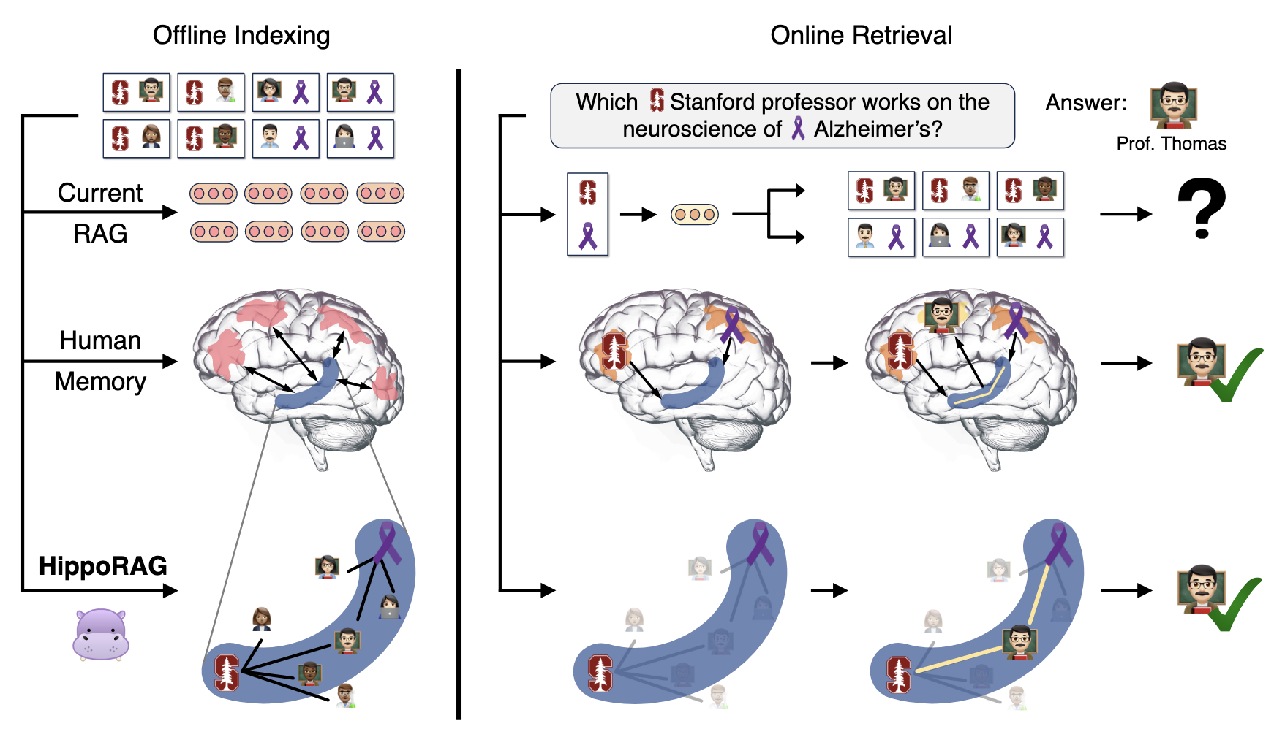
Issues with RAG 1.0
May fail for complex multi-hop queries
source: HippoRAG: Neurobiologically Inspired Long-Term Memory for Large Language Models

Slide 3
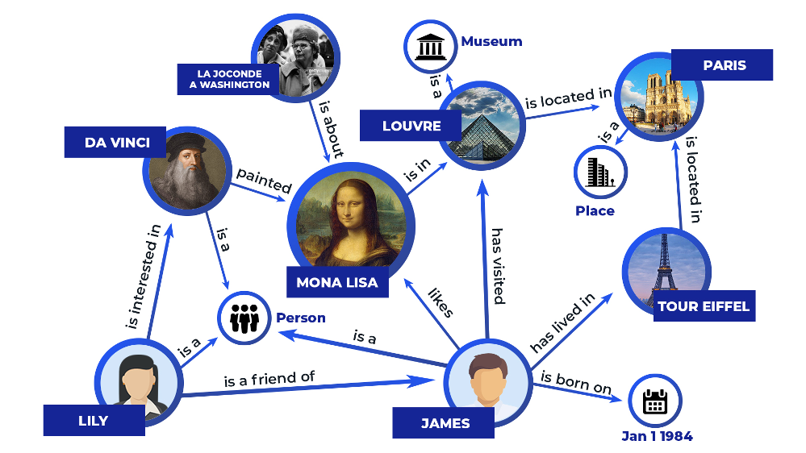
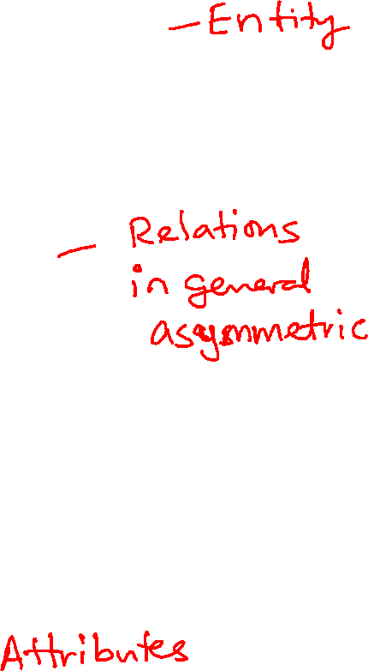
What is a knowledge graph (KG)?

Slide 4
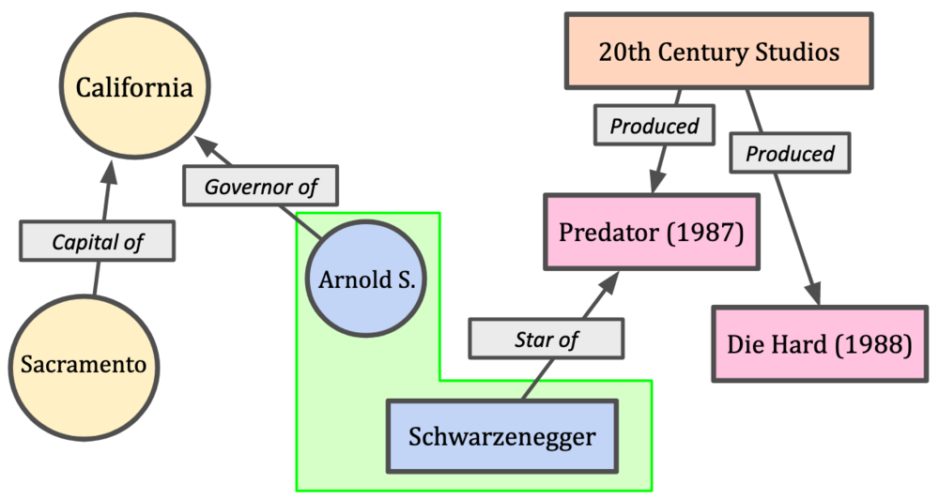
Another KG fragment

Slide 5
How about retrieving from knowledge graphs?
Which high school did Obama’s mother attend?
KGs are a set of (subject, relation, object) triples
Fields are opaque IDs, not strings
  Mapping from ID to strings in multiple languages
Question decomposition and multi-hop reasoning needed
  Question can be represented as an incomplete graph
KG has hundred billion edges
  Too big for LLM context, must retrieve; how?
Obama
Obama
had-mother
Subject | Relation | Object
Obama | attended-school | Punahou
Obama | had-mother | Ann Dunham
Ann Dunham | attended-school | Eckstein Junior High
?m
attended-school
?s

Slide 6
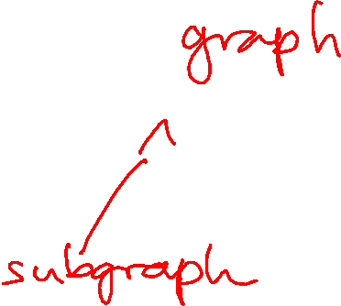
A generic pseudocode using “retrieval tool”
Preprocess and index corpus; encode prompt
Go into “thinking tokens” mode
For every “thinking token”
  Decide if LLM needs to retrieve
  If yes, compose a query for the “retrieval tool”
  Paste returned docs/passages into context
Switch to “reasoning and generation” mode
  Emit response
(May move between thinking, retrieval, reasoning states multiple times before final generation)

Slide 7
Linking, retrieval, reasoning, generation
Need to link question to entities in KG
  Disambiguation of John Smith
  Oblique reference “first president”, “red planet”
  Usually also need to link relations
In general, need to retrieve a subgraph of the KG
  Contains linked entities and answer elements
  Plus evidence nodes/edges in favor of answers
Reasoning and generation use retrieved subgraph
  May be transcribed to text for context injection

Slide 8
Retrieval from KG
“Differentiable KG”
Adapter between LM and KG
  KnowBERT, KAdapter, QA-GNN
Transcribe KG to text and fine-tune LM
  KG-BERT, KGLM
  Transcribe KG to text at test time
  KGT5, KGT5context
KG completion with/out corpus support
  IR4KGC, ReSKGC

Slide 9
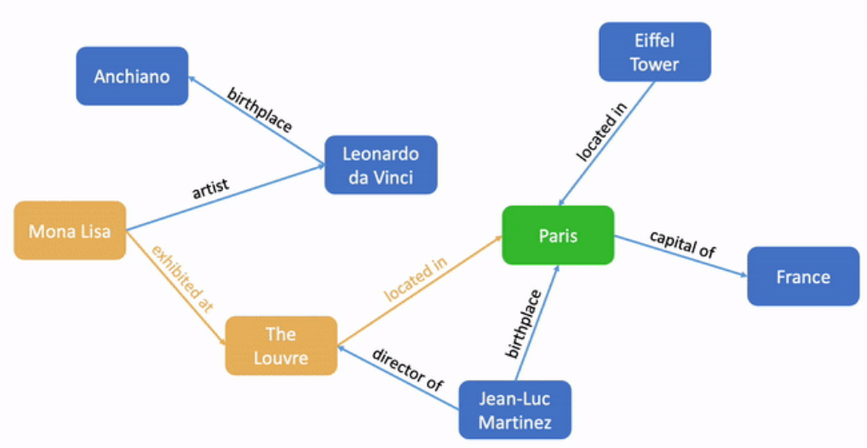
“Differentiable KG”
Find dense query embedding (e.g., using BERT)
Find dense graph embedding (e.g., GCN, graph transformer)
Cross attention layers establish correspondences between query and graph elements
Answer selection identifies graph element(s) to transcribe to response
  End-to-end trainable, no logical form needed
  Not easily interpretable
What city is the Mona Lisa in?
Contextual text representation
Answer selection
Cross-attention network
Paris
Graph representation learning
Notes:
In the alternative scheme, sometimes called “differentiable KG”,
text-specific and graph-specific encoders convert the question and KG to representations in a shared space.
A suitable matching network establishes a relevant subgraph of the KG that matches significant question elements.
An answer selection module identifies node/s in the relevant subgraph that are transcribed to the output response text.
The advantage of this approach is that the system is end-to-end trainable with only question-answer pairs.
The perimeter of successful questions is less brittle: all decisions are based on smooth representations, distributions, and operators.
When neural KGQA fails, though, the reason may be harder do debug than with semantic interpretation.
Because of its intimate connection to KG representation, we will spend most of our time on this family of approaches.

Slide 10
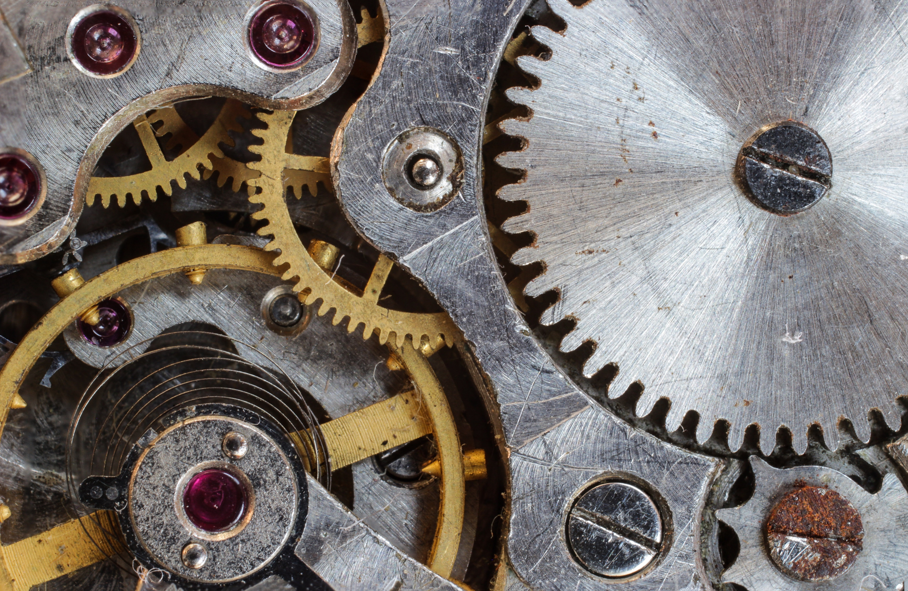
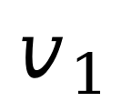
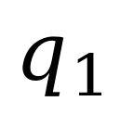
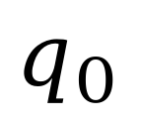
KVMNet/KVMemNN: Explore KG chains
Subject | Relation | Object
Obama | attended-school | Punahou
Obama | had-mother | Ann Dunham
Ann Dunham | attended-school | Eckstein Junior High
Distribution /
“attention”
over all rows
of the KG
Key
Value
Attention-weighted
value vector, close
to Ann Dunham’s
KG representation
$$q_{0}$$
$$v_{1}$$
$$q_{1}$$
Query encoder
Query vector
for next round
Where did Obama’s mother attend school?
Notes:
KVMNet is among the oldest and prototypical example of using KG embeddings in a QA system.
Without paying too much attention to the specifics of encoder and other network elements, let us outline the broad principle.
Consider the two-clause or two-hop query …

Slide 11
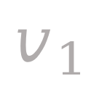
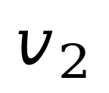
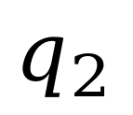
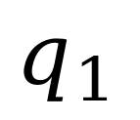
KVMNet: Second hop
Subject | Relation | Object
Obama | attended-school | Punahou
Obama | had-mother | Ann Dunham
Ann Dunham | attended-school | Eckstein Junior High
Second hop
“attention”
over all rows
of the KG
Key
Value
Answer vector
close to “Eckstein
Junior High”
$$q_{1}$$
$$v_{2}$$
Some residue of question
“where did Obama’s mother attend school”
together with Ann Dunham
“Nothing
more to ask”
$$q_{2}$$
$$v_{1}$$
Notes:
The second round question embedding is expected to discard “Obama’s mother” and bring in some representation of “Ann Dunham”.
This time, when the query q_1 is looked up…
The critical property in KVMNet is that the value returned in each round is a differentiable function of inputs.

Slide 12
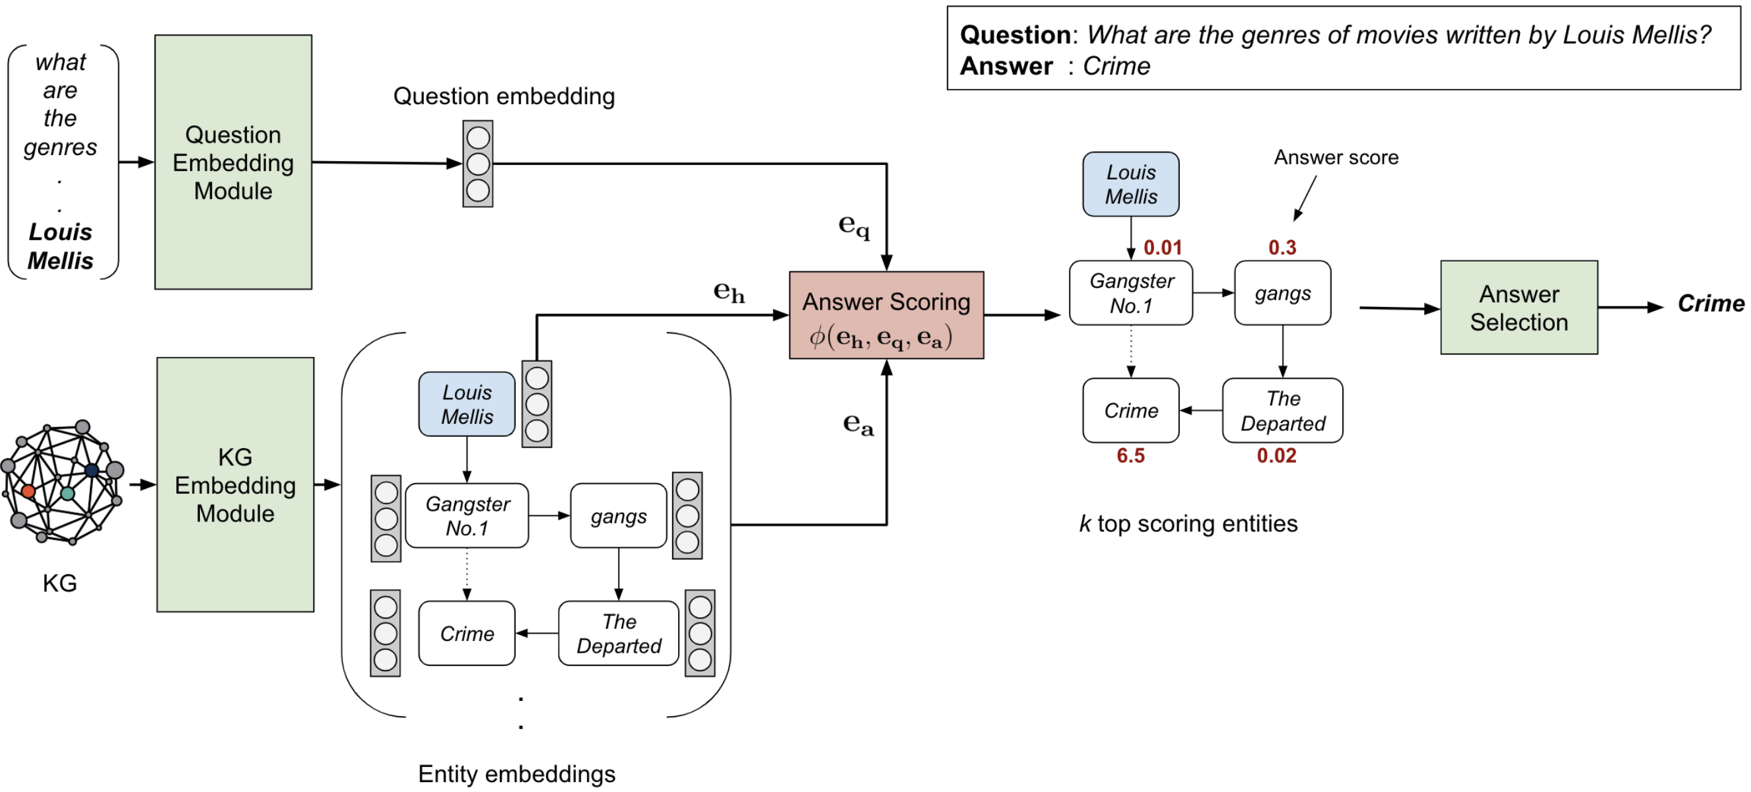
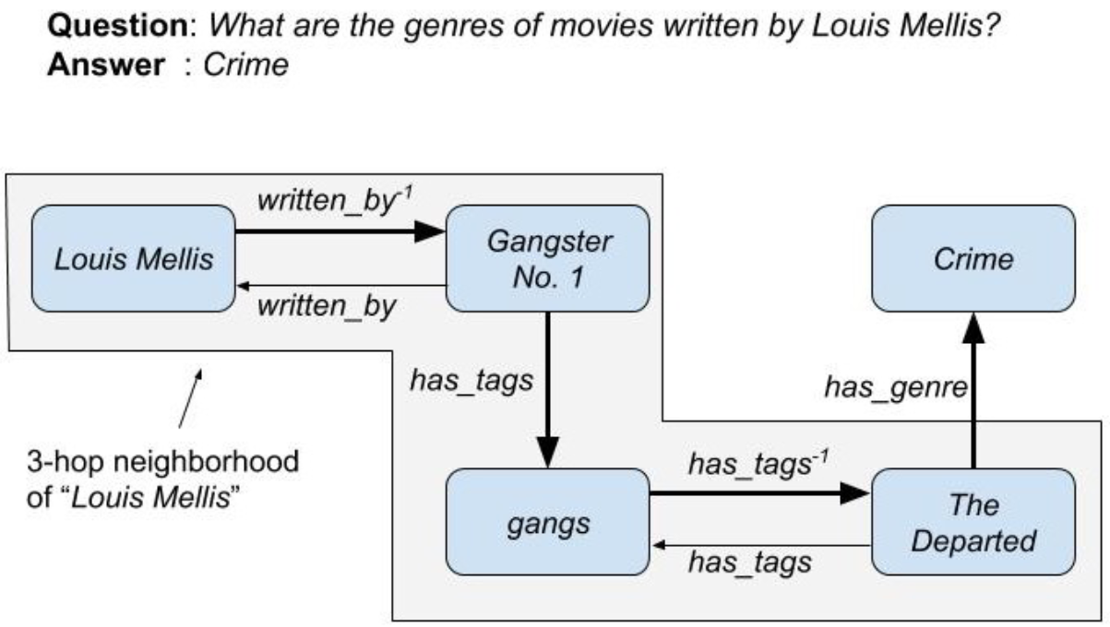
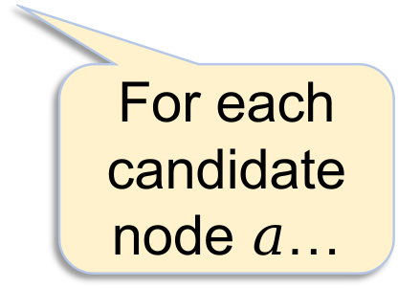
EmbedKGQA (2020)
Question encoding
Entity linking
For each candidate node $a$…
… score candidate wrt query, query entity and candidate embeddings
ComplEx embeddings (TODO)

Slide 13
Sample results
 | 1-hop | 2-hop | 3-hop
KVMNet | 96.2 | 82.7 | 48.9
GraftNet | 97.0 | 94.8 | 77.7
PullNet | 97.0 | 99.9 | 91.4
EmbedKGQA | 97.5 | 98.8 | 94.8
MetaQA full-KG benchmark
PullNet, GraftNet, more sophisticated graph retrieval
Increasing hop count more difficult for all
EmbedKGQA (likely) wins from
  Better knowledge graph embeddings (ComplEx)
  Better query representation via RoBERTa
  Fewer moving parts, simpler integration, easier training
Notes:
Turns out this extremely simple architecture is very effective.
It improves upon KVMnet, GraftNet and a successor, PullNet, for 1 and 3 hop queries, and is second-best for 2-hop queries.
As expected, questions that need more hops are more difficult for all systems.
It is likely that EmbedKGQA succeeds because …

Slide 14
Retrieval from KG
“Differentiable KG”
Adapter between LM and KG
  KnowBERT, KAdapter, QA-GNN
Transcribe KG to text and fine-tune LM
  KG-BERT, KGLM
  Transcribe KG to text at test time
  KGT5, KGT5context
KG completion with/out corpus support
  IR4KGC, ReSKGC

Slide 15
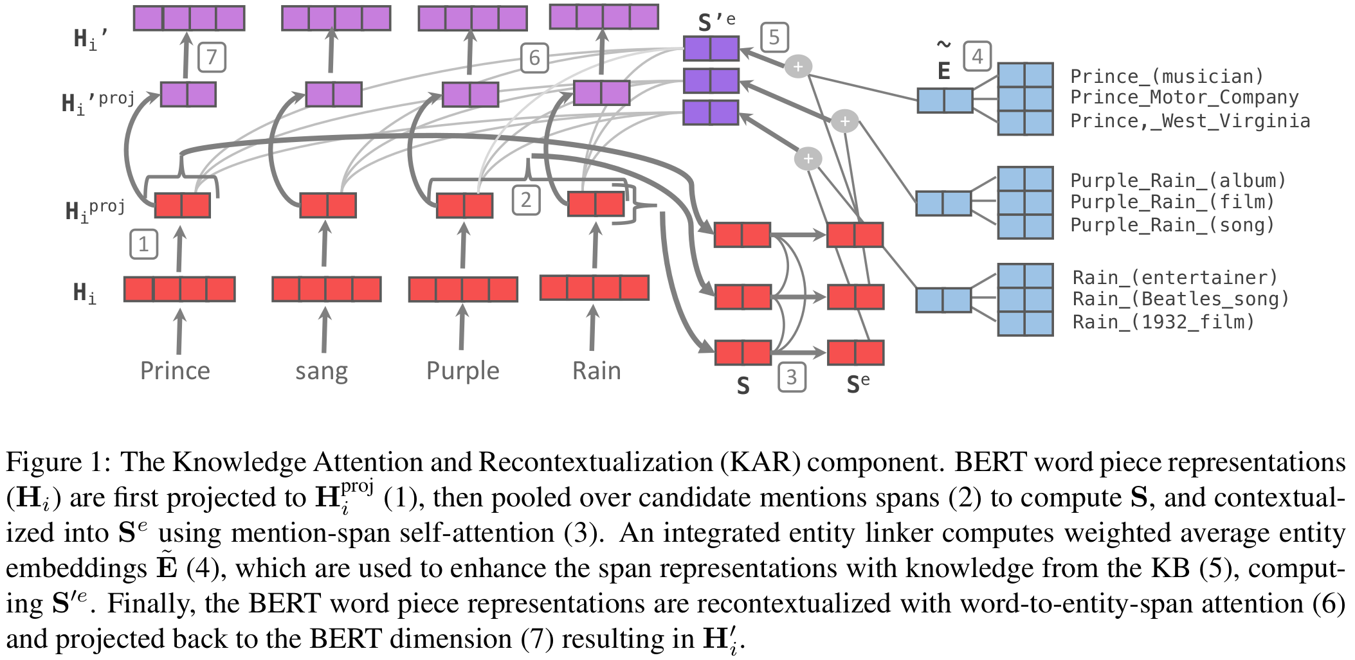
KnowBERT (2019) ― LM adaptation

Slide 16
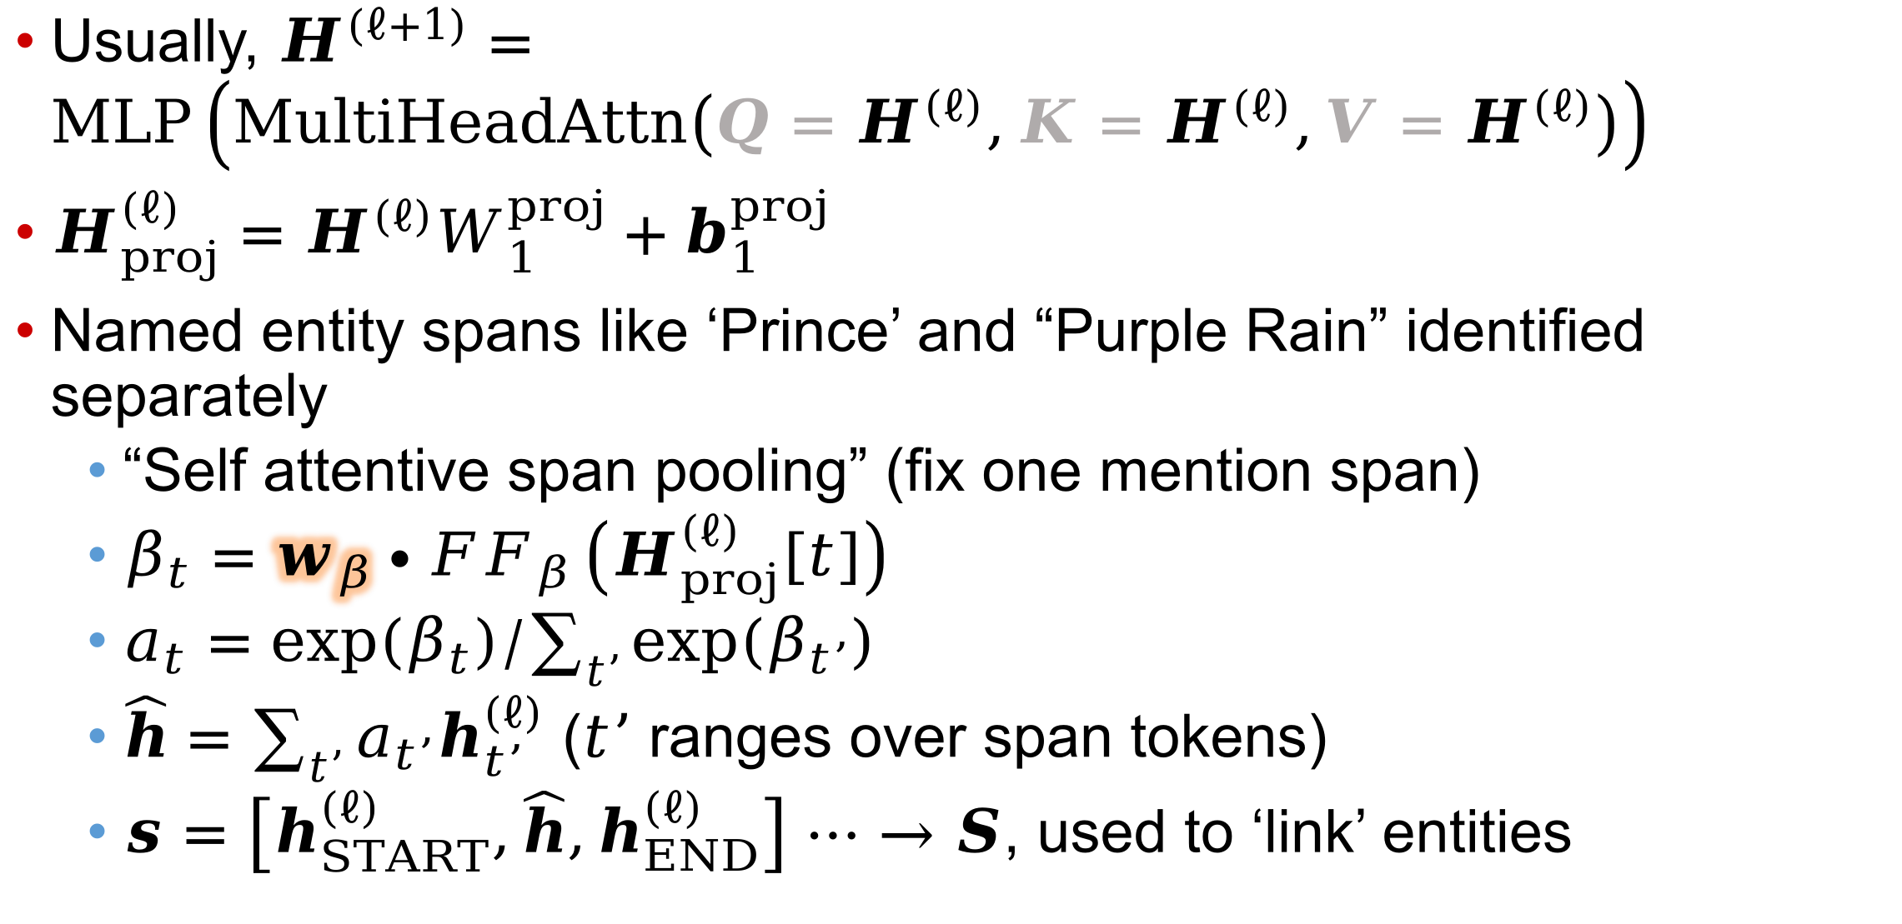
KnowBERT details
Usually, $H^{\left(ℓ+1\right)}=MLP\left(MultiHeadAttn\left({Q=H}^{\left(ℓ\right)},{K=H}^{\left(ℓ\right)},{V=H}^{\left(ℓ\right)}\right)\right)$
$H_{proj}^{\left(ℓ\right)}=H^{\left(ℓ\right)}W_{1}^{proj}+b_{1}^{proj}$
Named entity spans like ‘Prince’ and “Purple Rain” identified separately
  “Self attentive span pooling” (fix one mention span)
  $β_{t}=w_{β}∙{FF}_{β}\left(H_{proj}^{\left(ℓ\right)}\left[t\right]\right)$
  $a_{t}=exp\left(β_{t}\right)/\sum_{t’}{exp\left(β_{t’}\right)}$
  $\hat{h}=\sum_{t’}{a_{t’}h_{t’}^{\left(ℓ\right)}}$ ($t’$ ranges over span tokens)
  $s=\left[h_{START}^{\left(ℓ\right)},\hat{h},h_{END}^{\left(ℓ\right)}\right]$ $⋯→S$, used to ‘link’ entities
There is some attempt to disambiguate to canonical entities

Slide 17
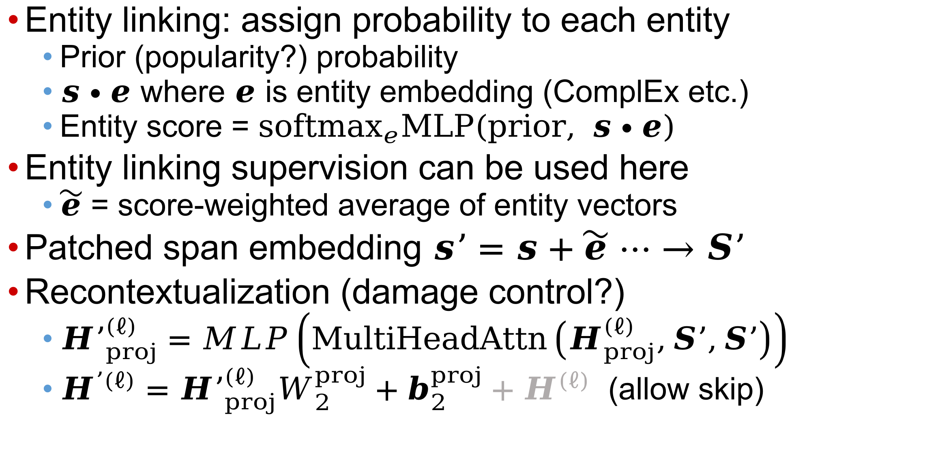
KnowBERT details
Entity linking: assign probability to each entity
  Prior (popularity?) probability
  $s∙e$ where $e$ is entity embedding (ComplEx etc.)
  Entity score = ${softmax}_{e}MLP\left(prior, s∙e\right)$
Entity linking supervision can be used here
  $\tilde{e}$ = score-weighted average of entity vectors
Patched span embedding $s’=s+\tilde{e} ⋯→S’$
Recontextualization (damage control?)
  ${H’}_{proj}^{\left(ℓ\right)}=MLP\left(MultiHeadAttn\left(H_{proj}^{\left(ℓ\right)},S’,S’\right)\right)$
  $H^{’\left(ℓ\right)}={H’}_{proj}^{\left(ℓ\right)}W_{2}^{proj}+b_{2}^{proj}+H^{\left(ℓ\right)}$ (allow skip)

Slide 18
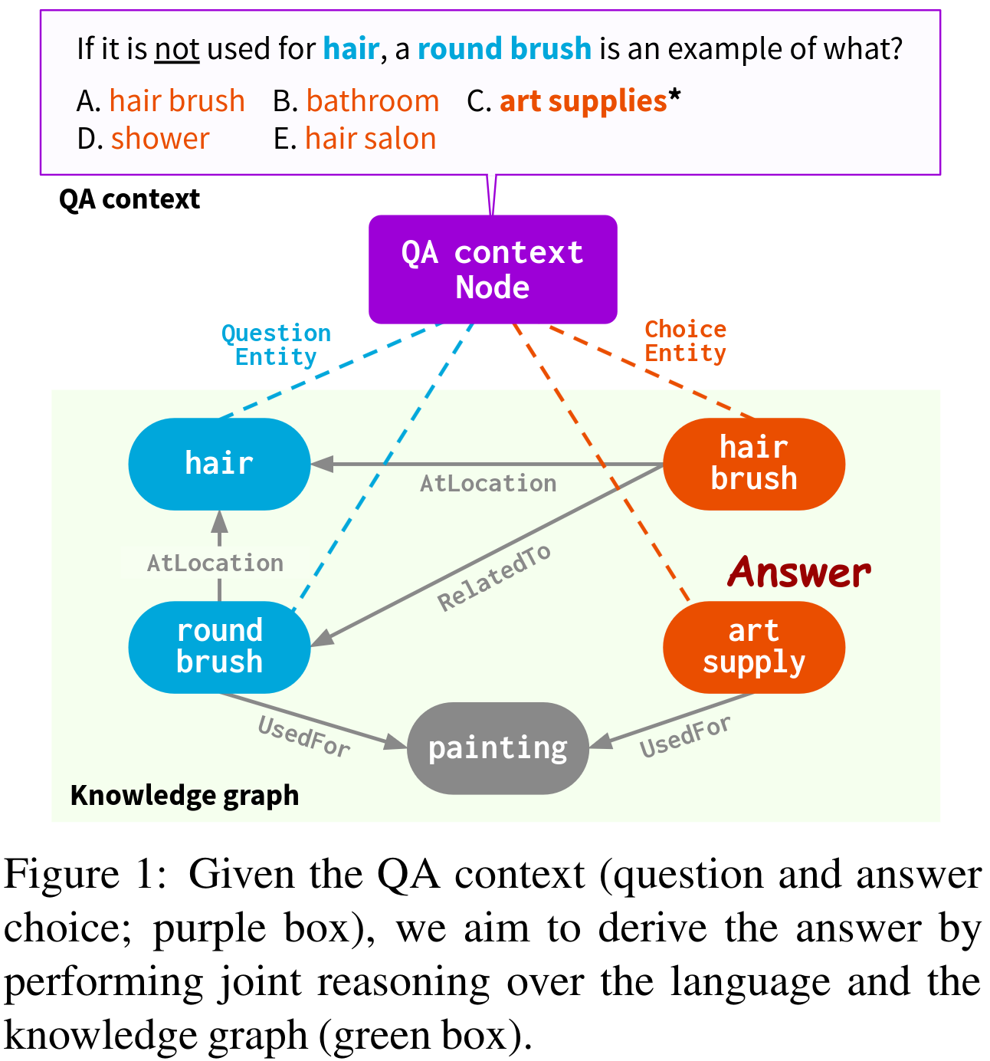
QA-GNN (2021)
MCQ style KG-QA
Question retrieves KG
Question is also a node
Each answer node attached in turn
Resulting graph processed by a GNN (TODO)
Combined with question encoding and scored

Slide 19
Retrieval and adaptation for KG
Fine tuning LM with KG information

Slide 20
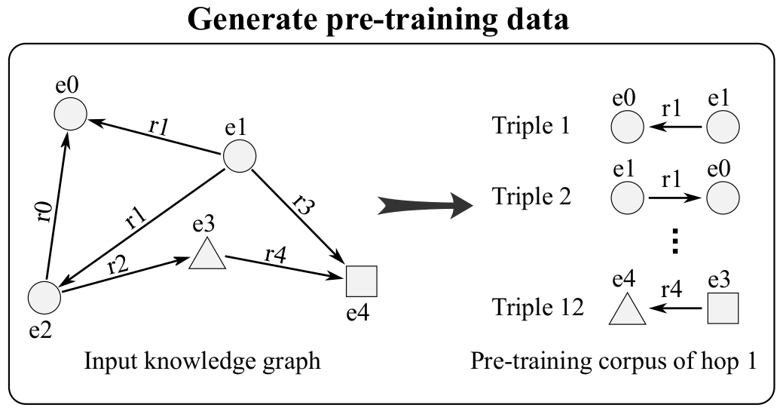
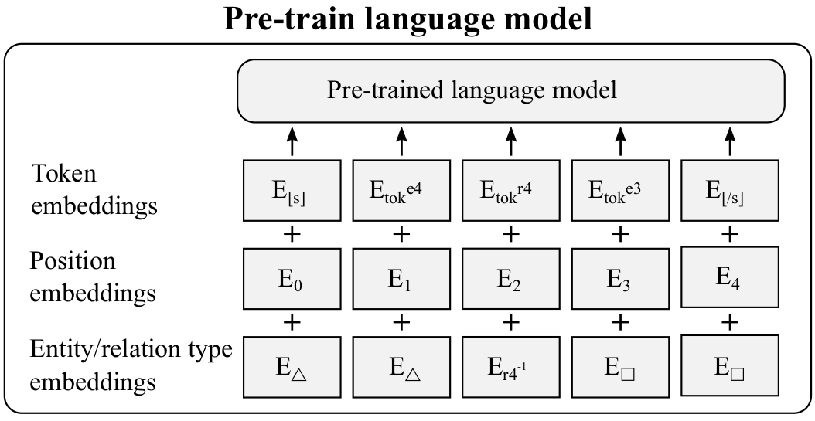
KGLM (2023)
Continued pretraining (of RoBERTa)
Textified KG edges
  Additional overlay beyond position embeddings
Sometimes improves on ComplEx for KG completion
  Not surprising, has more information

Slide 21
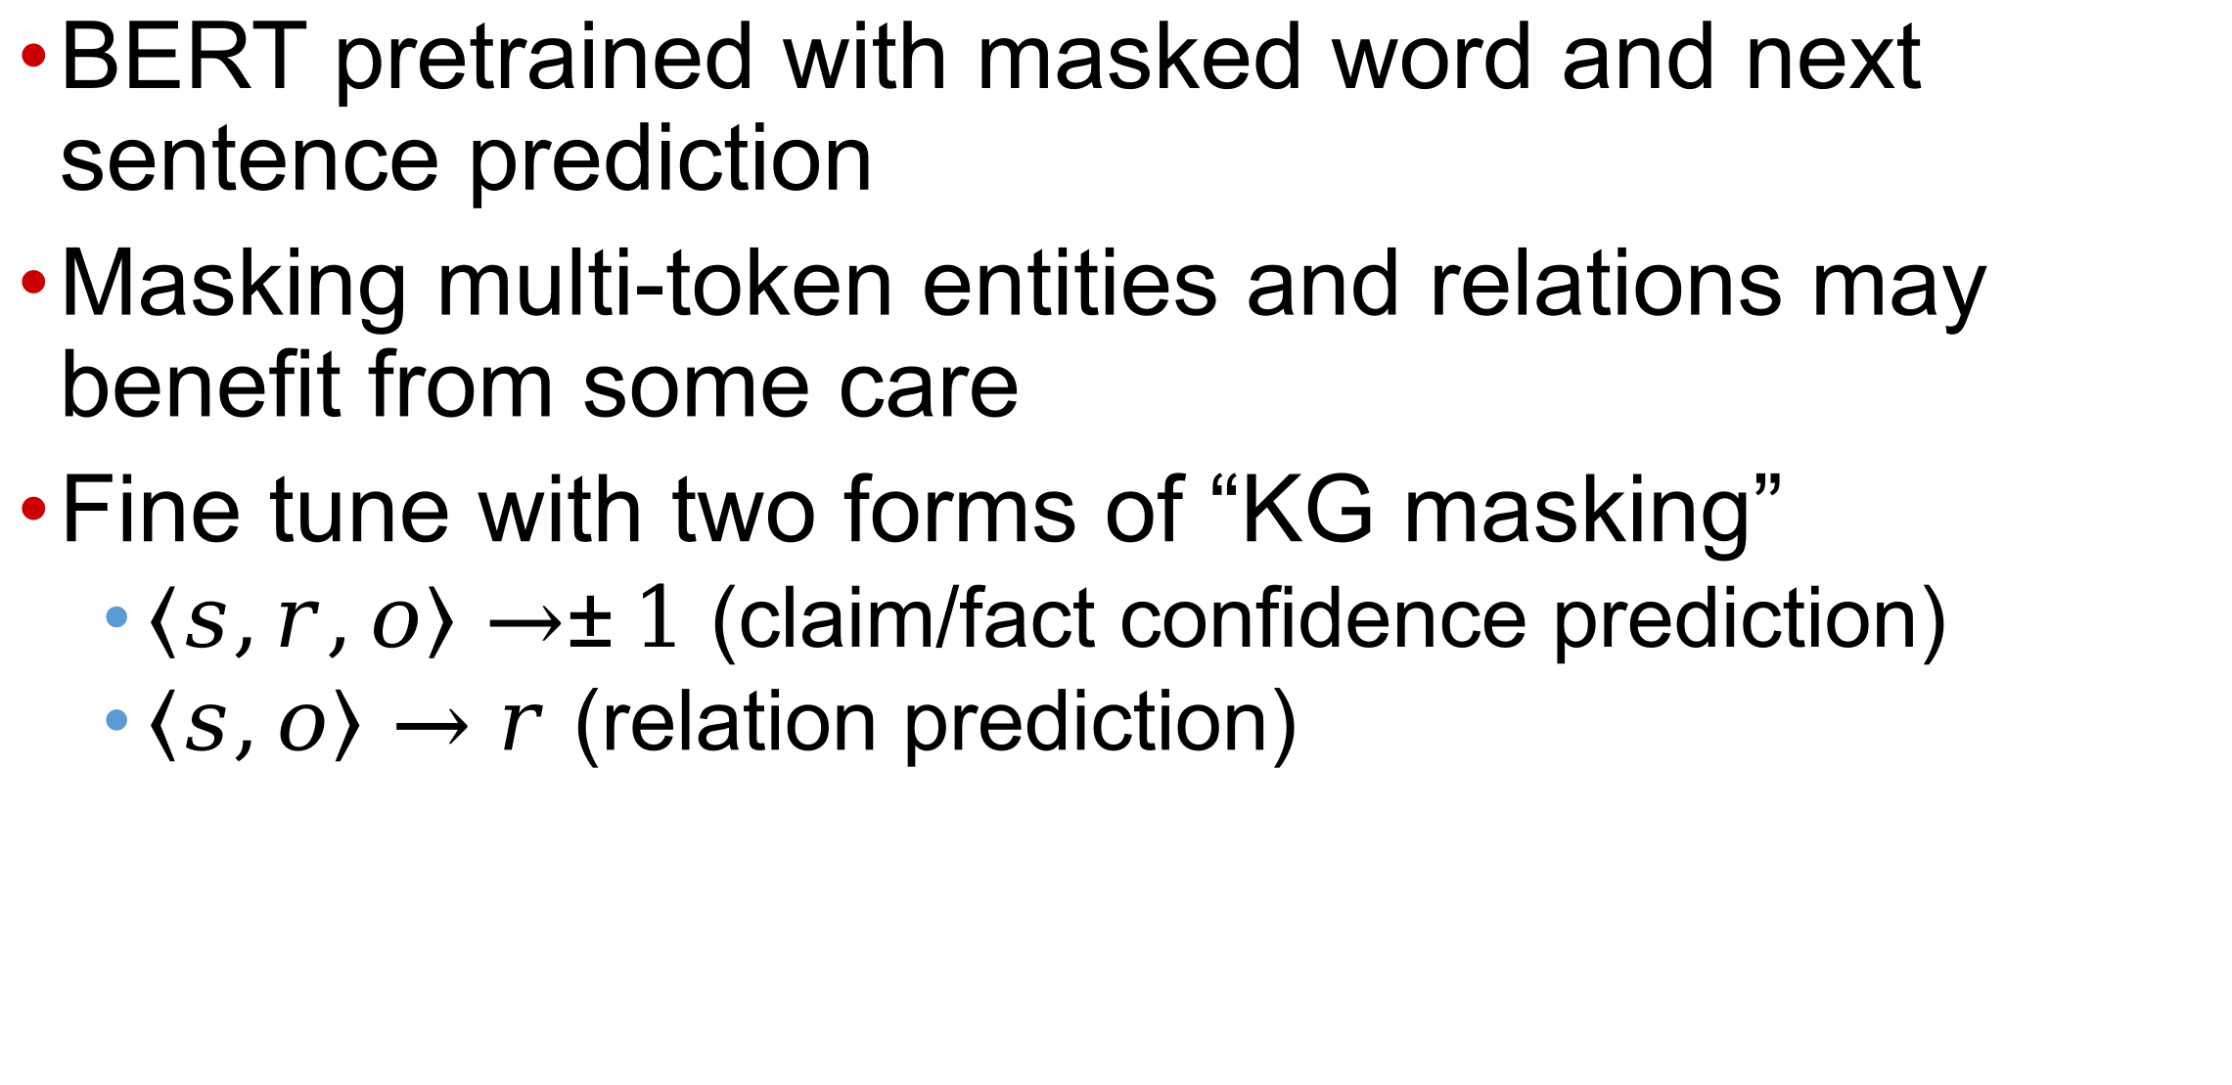
KG-BERT (2019)
BERT pretrained with masked word and next sentence prediction
Masking multi-token entities and relations may benefit from some care
Fine tune with two forms of “KG masking”
  $〈s,r,o〉→±1$ (claim/fact confidence prediction)
  $〈s,o〉→r$ (relation prediction)

Slide 22
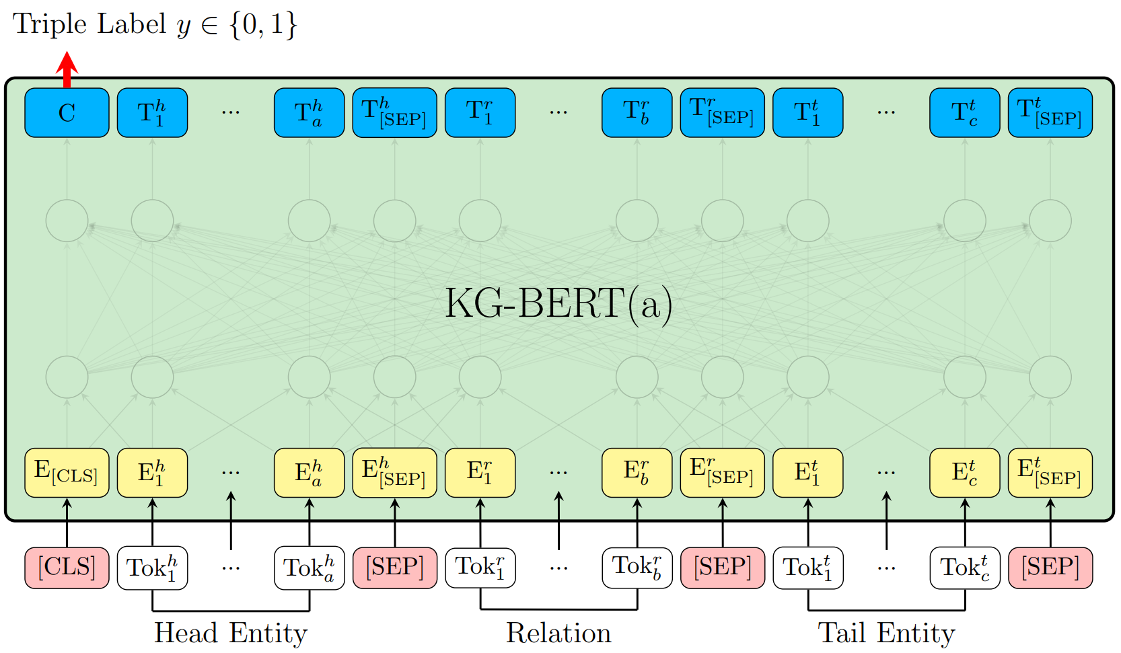
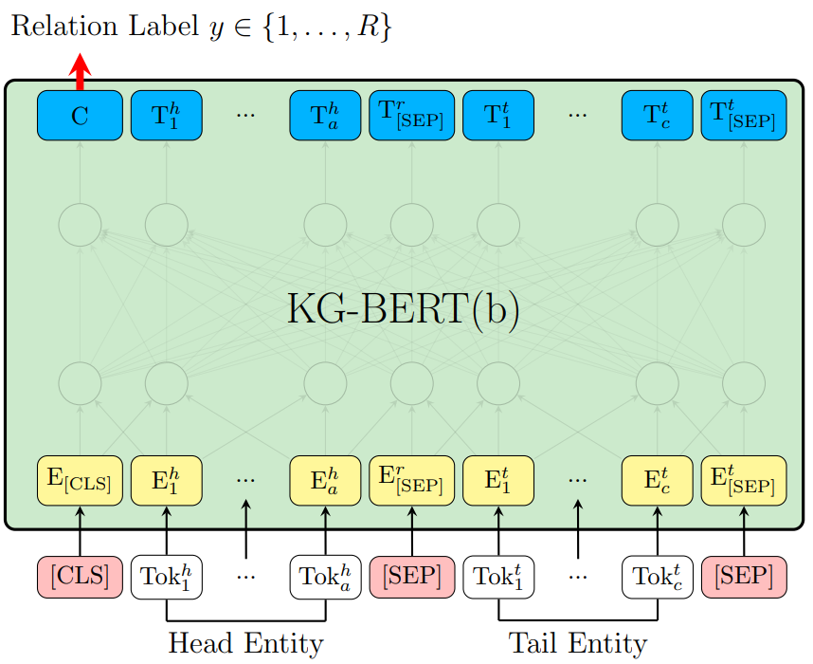
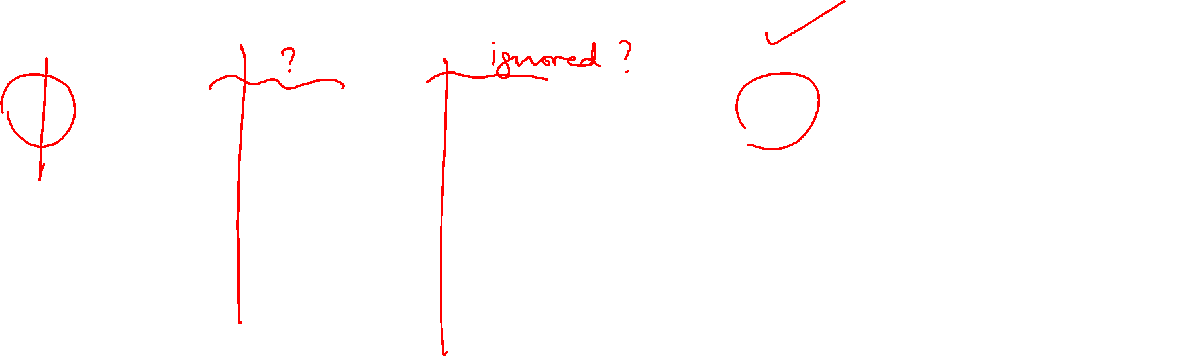
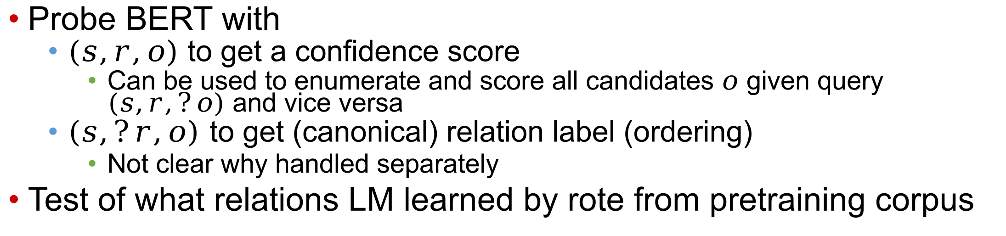
KG-BERT (2019)
All inputs are textualized
HITS@10 worse than ComplExN3 SOTA
Probe BERT with
  $(s,r,o)$ to get a confidence score
    Can be used to enumerate and score all candidates $o$ given query $(s,r,?o)$ and vice versa
  $\left(s,?r,o\right)$ to get (canonical) relation label (ordering)
    Not clear why handled separately
Test of what relations LM learned by rote from pretraining corpus

Slide 23
Fine tuning LM with KG information
Prompting LM using KG excerpts

Slide 24
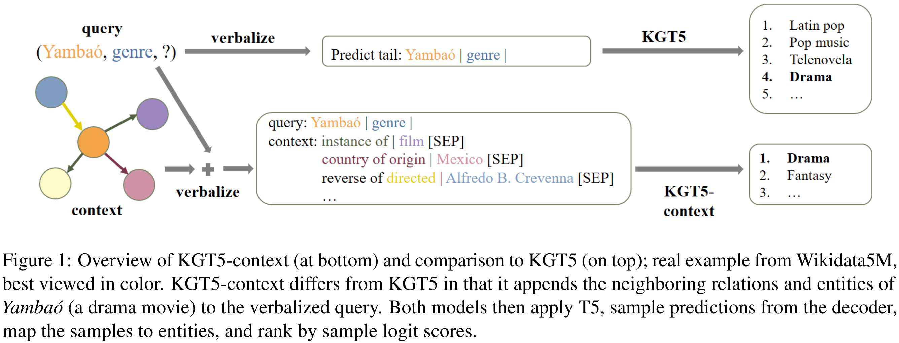

KGT5 (2022) and KGT5context (2023)
But there is one more signal to exploit
  Additional examples of test relation (genre)

Slide 25
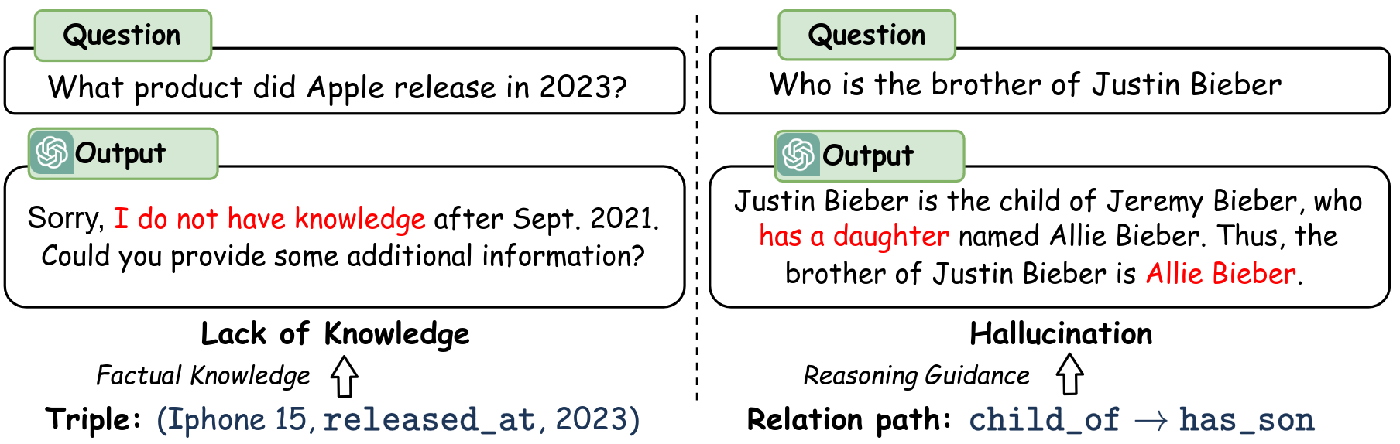
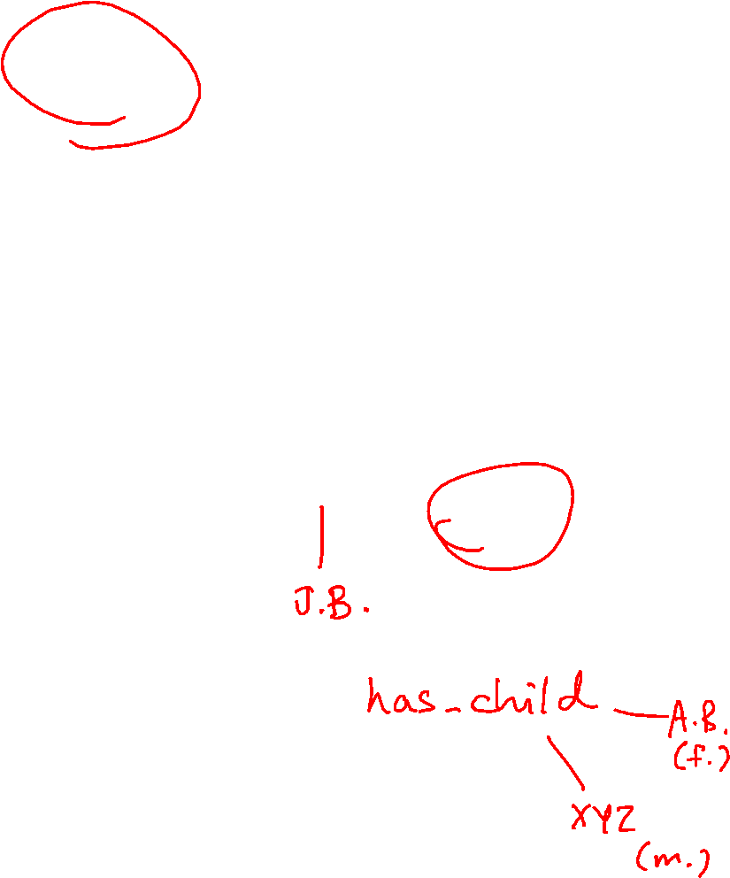
Reasoning on Graphs (2024)
Two ways KG can assist LM-based QA
  Supplement knowledge
  Prevent hallucination with path guidance

Slide 26
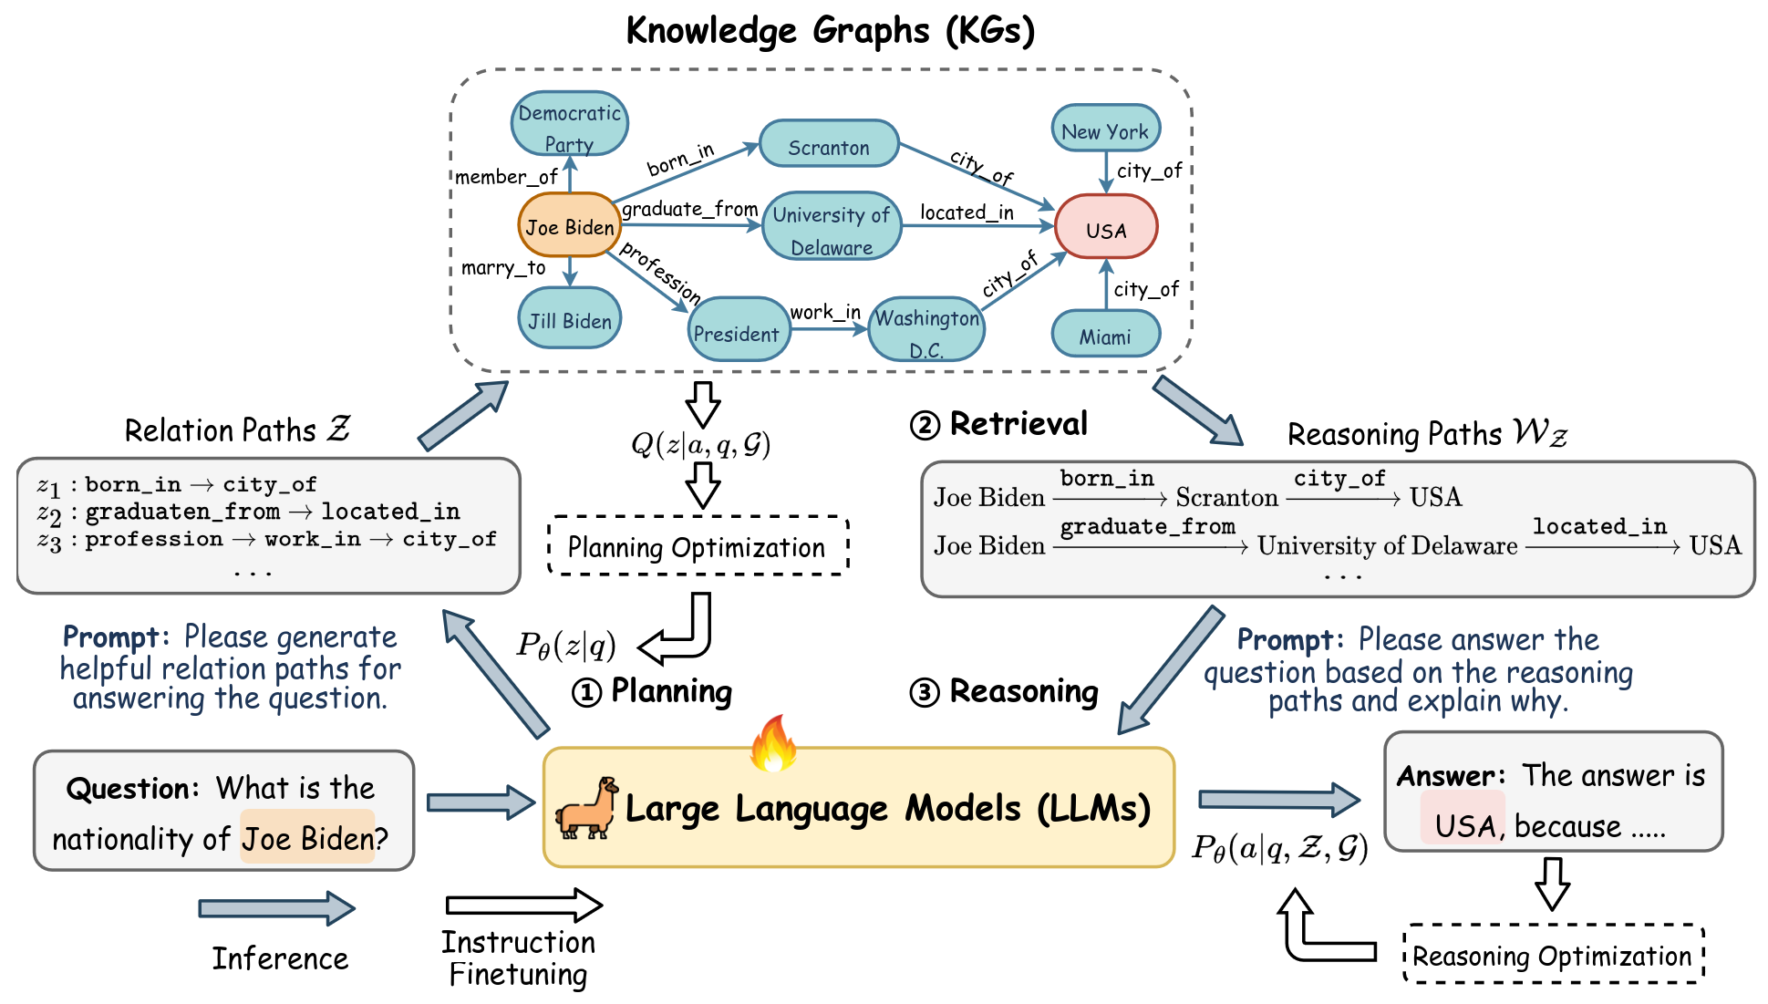
RoG mechanism

Slide 27
RoG steps
Planning
  Select subset of (short) relation type paths, given the question
Retrieval
  Expand from anchor nodes, using paths that match the path patterns, thus collecting subgraph
Reasoning
  Textify retrieved subgraph, then depend on LLM magic to reason and generate answer

Slide 28
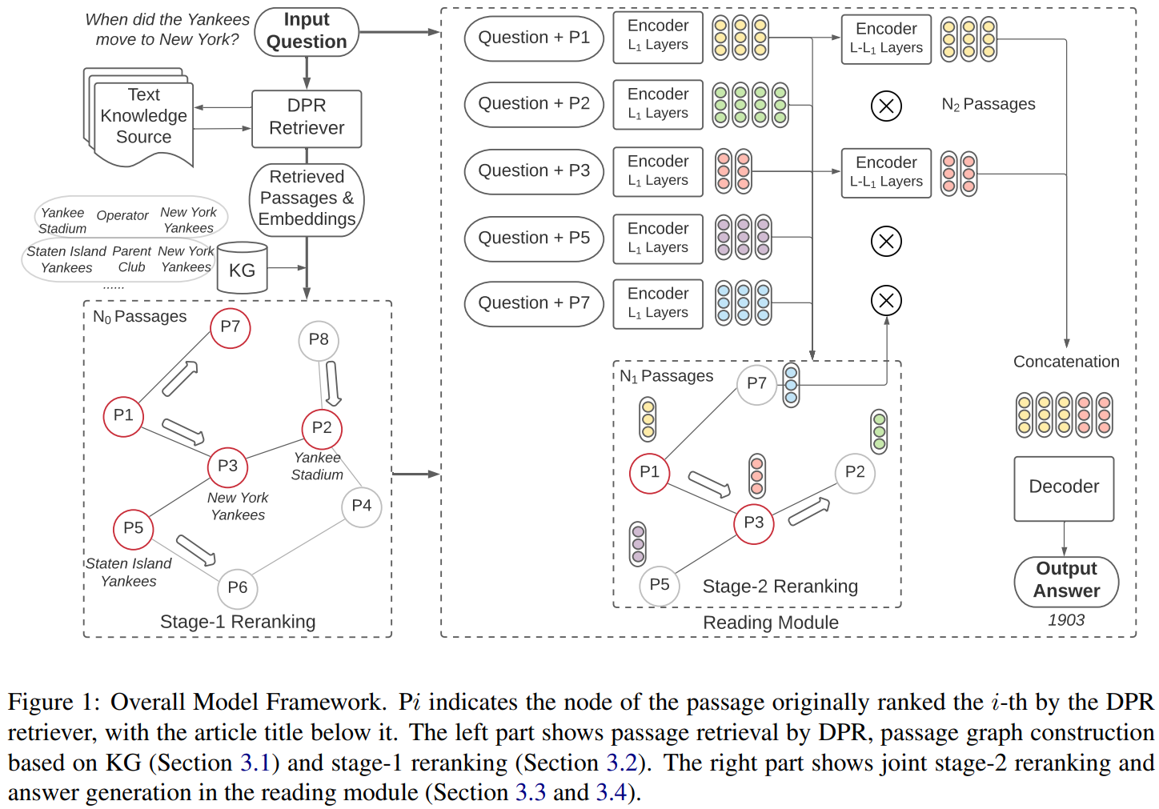
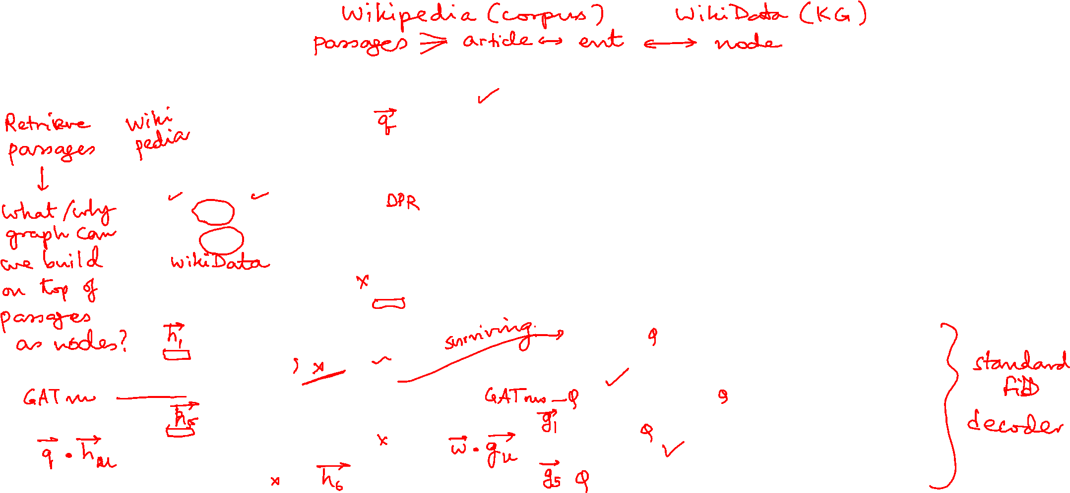
KG-FiD (2021)

Slide 29
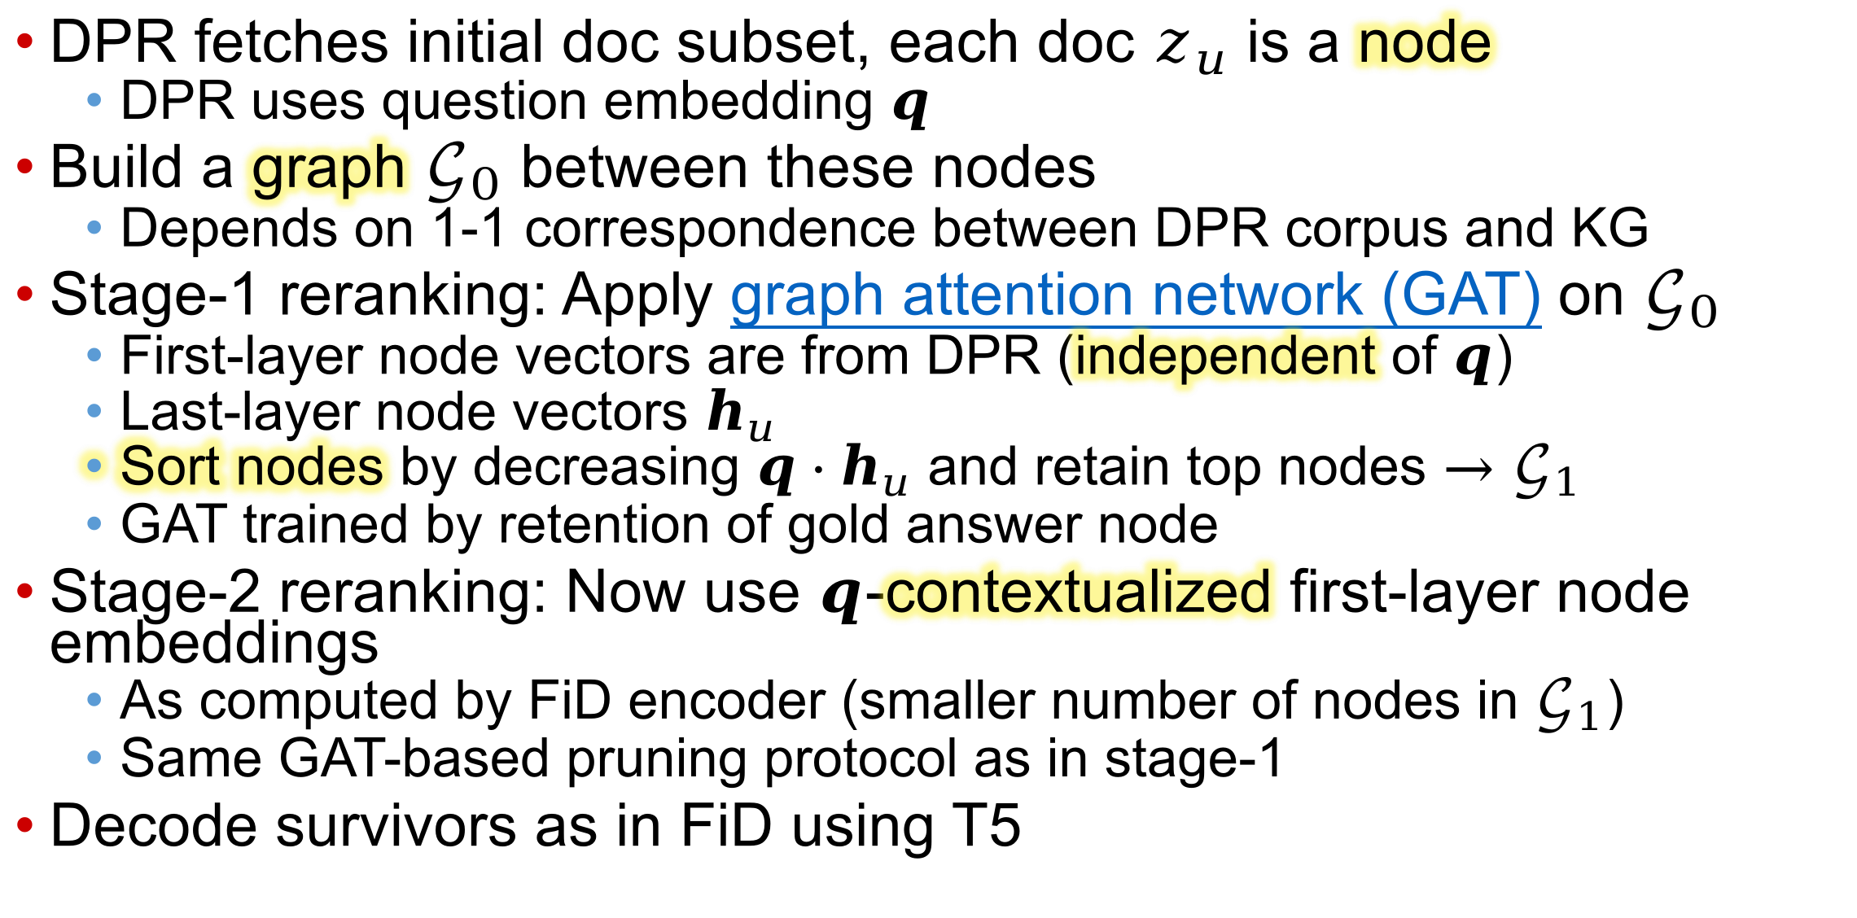
KG-FiD details
DPR fetches initial doc subset, each doc $z_{u}$ is a node
  DPR uses question embedding $q$
Build a graph $𝒢_{0}$ between these nodes
  Depends on 1-1 correspondence between DPR corpus and KG
Stage-1 reranking: Apply graph attention network (GAT) on $𝒢_{0}$
  First-layer node vectors are from DPR (independent of $q$)
  Last-layer node vectors $h_{u}$
  Sort nodes by decreasing $q⋅h_{u}$ and retain top nodes $→𝒢_{1}$
  GAT trained by retention of gold answer node
Stage-2 reranking: Now use $q$-contextualized first-layer node embeddings
  As computed by FiD encoder (smaller number of nodes in $𝒢_{1}$)
  Same GAT-based pruning protocol as in stage-1
Decode survivors as in FiD using T5

Slide 30
Graph RAG
source: HippoRAG: Neurobiologically Inspired Long-Term Memory for Large Language Models

Slide 31
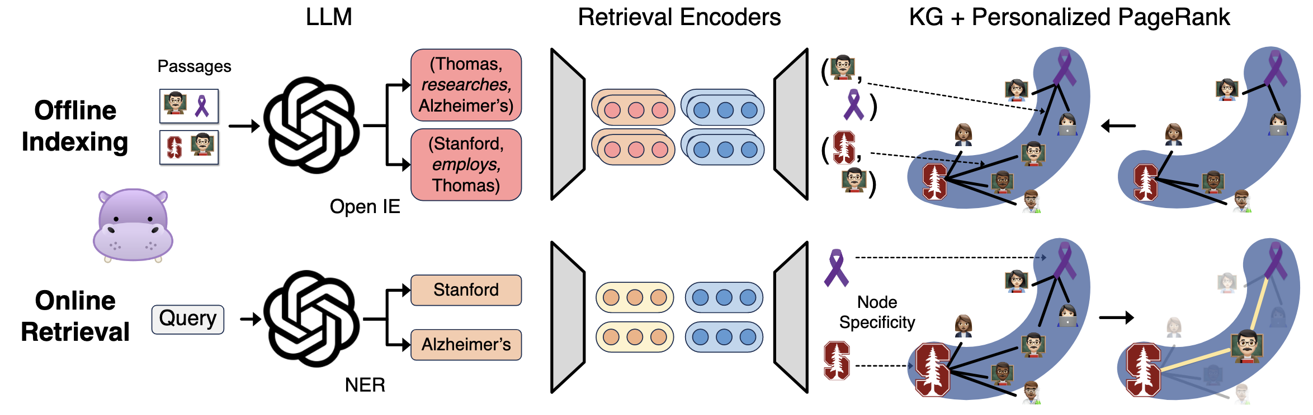
Hippo RAG – Offline Indexing
KG
1. OpenIE - Extract noun phrases & relations
2. Add Synonymy relations: Encode noun phrases via encoder & join similar nodes
3. Store node embeddings
4 . Store KG
5. Store noun-phrase → Passage id mapping
source: HippoRAG: Neurobiologically Inspired Long-Term Memory for Large Language Models

Slide 32
Hippo RAG – Offline Indexing
KG
1. OpenIE - Extract noun phrases & relations
2. Add Synonymy relations: Encode noun phrases via encoder & join similar nodes
3. Store node embeddings
4 . Store KG
5. Store noun-phrase → Passage id mapping
source: HippoRAG: Neurobiologically Inspired Long-Term Memory for Large Language Models

Slide 33
Hippo RAG – Offline Indexing
KG
1. OpenIE - Extract noun phrases & relations
2. Add Synonymy relations: Encode noun phrases via encoder & join similar nodes
3. Store node embeddings
4 . Store KG
5. Store noun-phrase → Passage id mapping
source: HippoRAG: Neurobiologically Inspired Long-Term Memory for Large Language Models

Slide 34
Hippo RAG – Query Time
Extract Subgraph – Personalized PageRank
LLM
Retrieval Encoders
1. Extract named entities from query
2. Encode named entities
3. Search in the index (recall we indexed node embeddings)
3. Subgraph sampling via PPR – extract nodes (noun phrases) in the nbhrhood
4. Extract the passages that mention the noun phrases
source: HippoRAG: Neurobiologically Inspired Long-Term Memory for Large Language Models

Slide 35
Hippo RAG – Query Time
Extract Subgraph – Personalized PageRank
LLM
Retrieval Encoders
1. Extract named entities from query
2. Encode named entities
3. Search in the index (recall we indexed node embeddings)
3. Subgraph sampling via PPR – extract nodes (noun phrases) in the nbhrhood
4. Extract the passages that mention the noun phrases

Slide 36
Hippo RAG – Query Time
Extract Subgraph – Personalized PageRank
LLM
Retrieval Encoders
1. Extract named entities from query
2. Encode named entities
3. Search in the index (recall we indexed node embeddings)
3. Subgraph sampling via PPR – extract nodes (noun phrases) in the nbhrhood
4. Extract the passages that mention the noun phrases
source: HippoRAG: Neurobiologically Inspired Long-Term Memory for Large Language Models

Slide 37
Additional references
Various paradigms of LMs accessing
  Passages as items from corpus
  KGs encoded via GNNs
  KG subgraphs presented as text
ACL tutorial focused on passage-RAG
Online course focused on KG-RAG
LMs cannot always adequately exploit long retrieval context

Slide 38
Summary and outlook
Even with long context support, focused retrieval is essential
Retrieve from passage, graphs, tables, charts, images, speech, video, brain signals, …
We will focus next on knowledge graphs
Then tables represented as graphs
Finally complete a survey of retrieval architectures
  Integration between LLMs and retrieval systems

